Slide 1
INFO6001 Lab Assignment 5 Steganography
Gihan Shamike Liyanage
1142109
Section A – 09/03/2023

Slide 2
Submission Instructions:
Take a screen-capture, or for better precision use the Snipping Tool to capture the required images of your work and paste in the provided Submission .pptx file for each Slide # 1 – 6 as per the lab instructions.
In the snips, please capture all VM tabs and try to leave any background images that help identify the process to your results (such as an open app or File Explorer window). If needed, open a CLI window and enter the [net config workstation | find “name”] command to display your systems details in the snip-capture. It is very helpful to insure each VM has had the View set to Fit Guest to eliminate any dead space around the VM display before you start to capture all of the needed content.
In the Powerpoint menu, click on the Insert tab and then Text Box and the use the cursor to create a separate box area on the slide to answer questions posed to you during the exercise. Insure that the text box stays completely on the actual slide and not in a margin or speakers notes area as only the slide is visible in the FOL marking view. Size the font minimum 14 and maximum 24. You may also create a separate slide for these answers but you must include the Part and step numbers of the question.
For Slide 6, you are to copy the yourFOLname.txt.aes file to the host (eg your Desktop) and then use the Insert / Object function in PowerPoint to browse for and embed the file into the slide 6.
You should then have this single .ppt file to submit the completed lab.

Slide 3
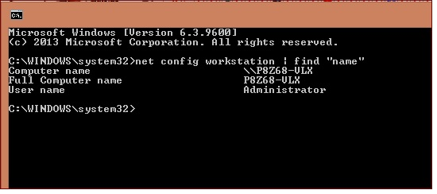
Submission Instructions:
Identify command for each slide.

Slide 4
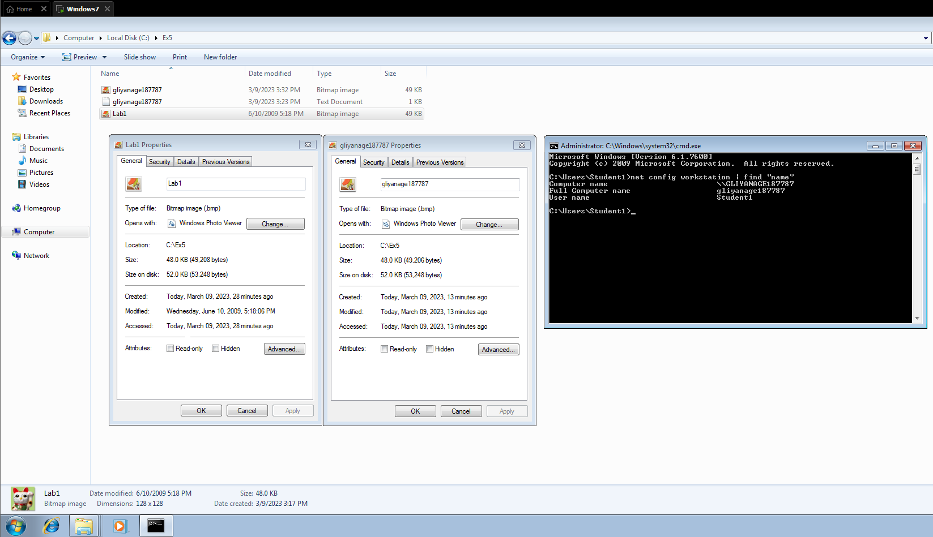
Slide #1 - Files Sizes (.3 marks)
Can you see any difference from the original .bmp file?? No visible difference
Is the information the same or different?? Same information
What is the size of both files?? 52KB (53 248 bytes)
Can you tell that a text file has been hidden in the .bmp file?? Can not tell

Slide 5
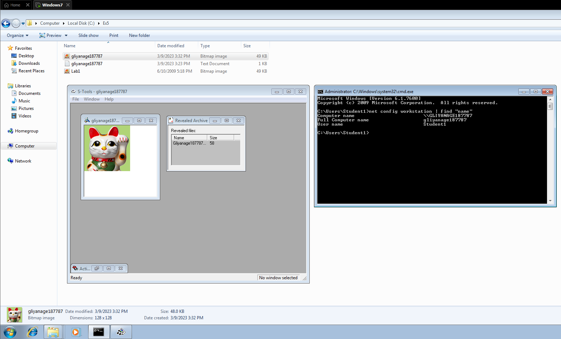
Slide #2 – Reveal Archive (.3 marks)

Slide 6
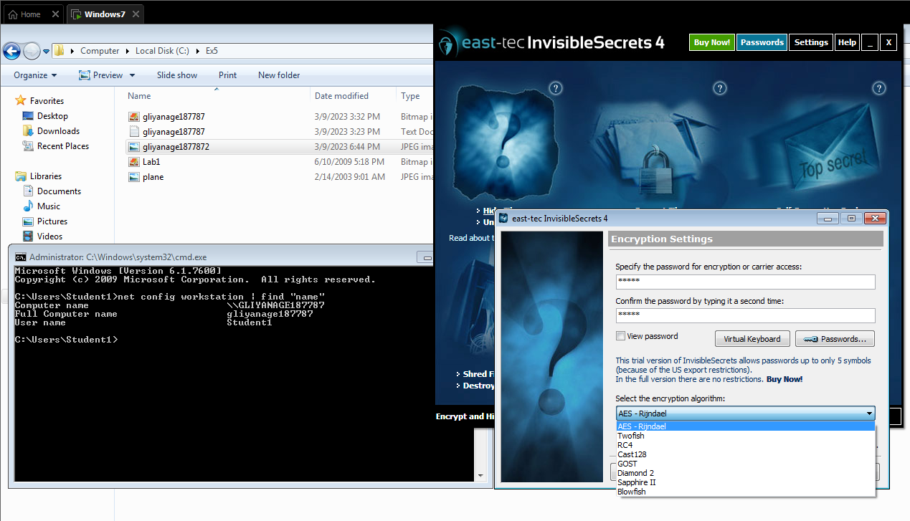
Slide #3 – Encryption Options (.3 marks)
Can you tell that a text file has been hidden inside the picture?? No visible diference
Check the size of both files?? 36KB

Slide 7
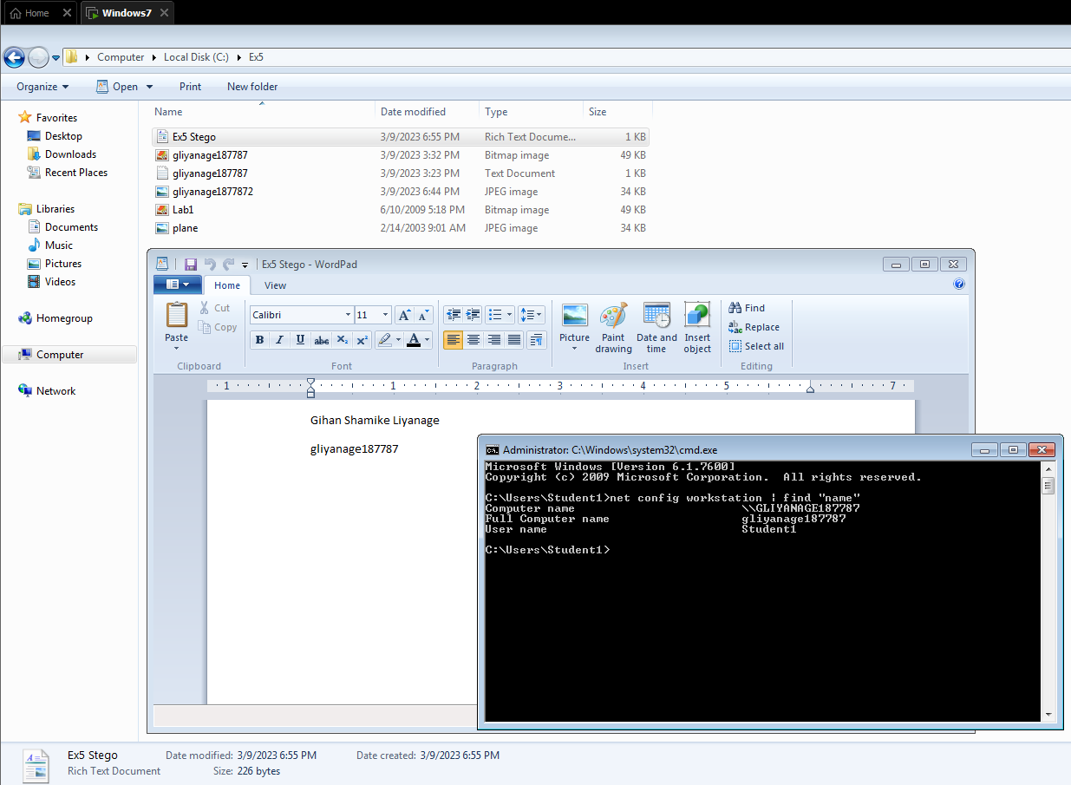
Slide #4 – FOL Username (.3 marks)

Slide 8
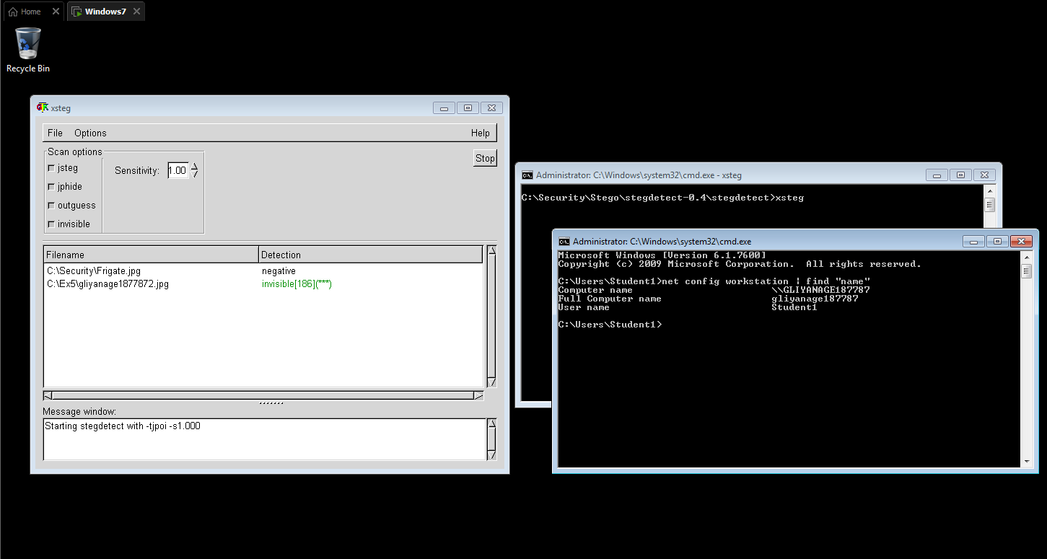
Slide #5 – Xsteg (.3 marks)

Slide 9
Slide #6 (.5 marks)
Copy the “yourFOLname.txt.aes” file from the VM and paste to the Host (e.g. your Desktop). Use PowerPoint function “Insert/Object/Create/Browse” to Embed the Encrypted file on this slide. No screen capture or separate file submission is required.

